Slide 1
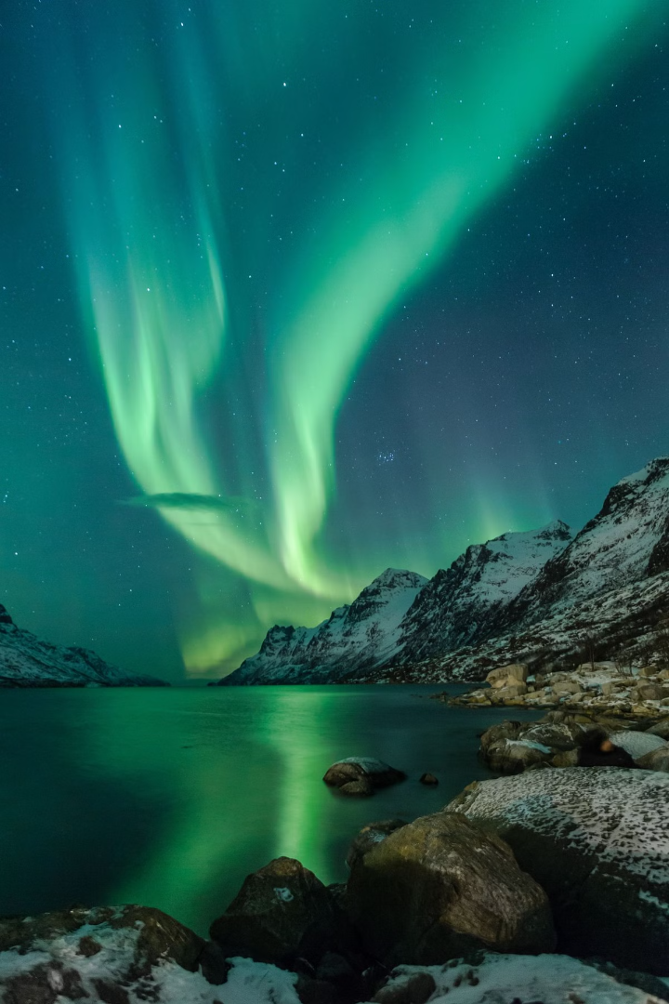
LightsTrail
Your Personal Aurora Forecasting Companion
Team Members:
Pooja Doddannavar
Aryaa Hanamar
Samarth Rayar
Siddharth Nashikkar

Slide 2

Project Overview
1
Real-time aurora predictions and forecasts
2
Location-based aurora tracking
3
Community Gallery for sharing experiences
4
Tourism Guide and Tour Booking
5
Alerts based on users preferred KP threshold and location

Slide 3
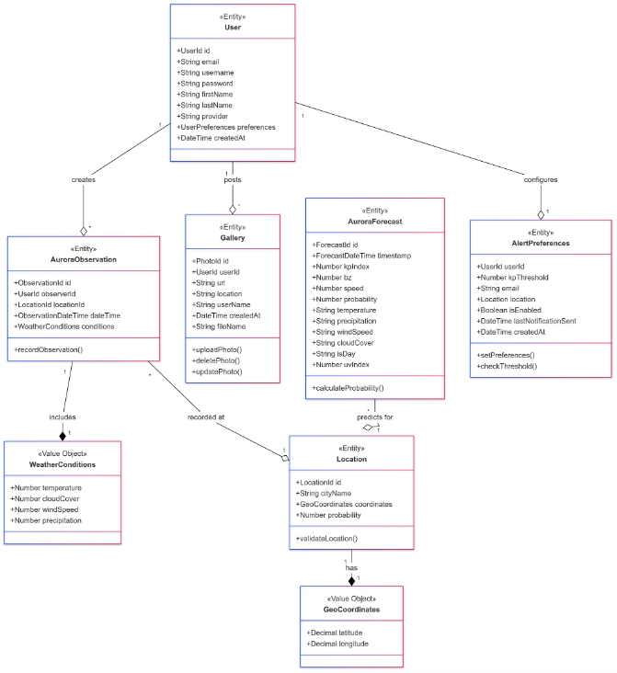
Domain Model

Slide 4
Technology Stack
Front-End
Back-End
Database
External APIs
React
Node.js
MongoDB
NOAA API
TypeScript
Express.js
Mongoose Schema
OpenWeather API
Material-UI
TypeScript
MongoDB Atlas
Mapbox API
Google OAuth2.0 API

Slide 5








Core Features
Real-time Aurora Forecasts
Aurora Alert System
Community Photo Gallery
Live Best Viewing Locations
Interactive Aurora Maps
Tour Booking
Live Aurora WebCam
Scientific Data

Slide 6
Technical Highlights
OAuth Authentication (Google + Local)
Redux State Management
RESTful API Design
Real-time Data Processing
Responsive UI/UX
PWA Implementation

Slide 7
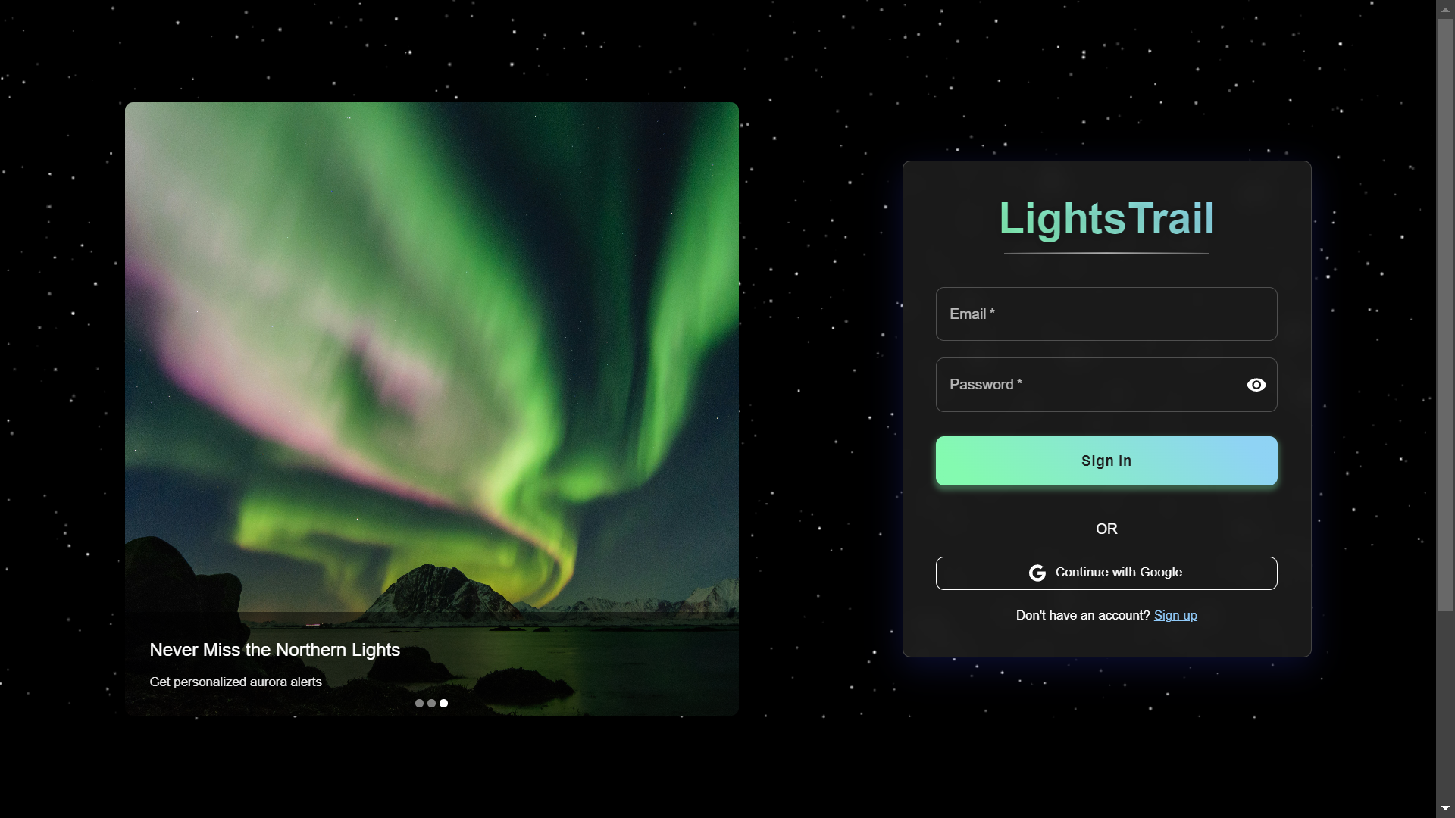
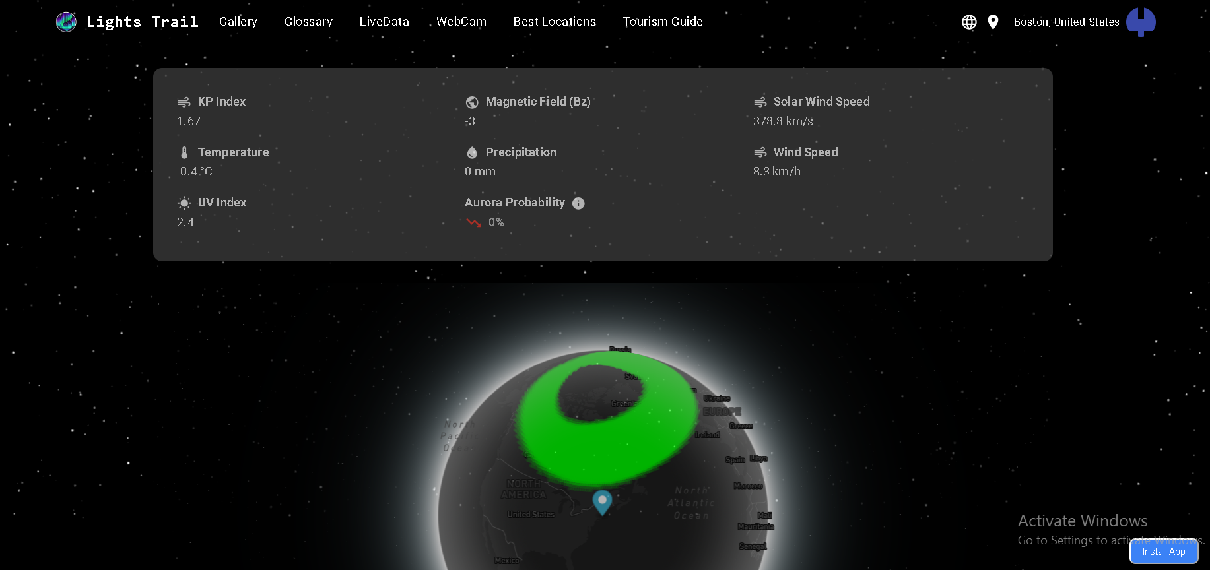
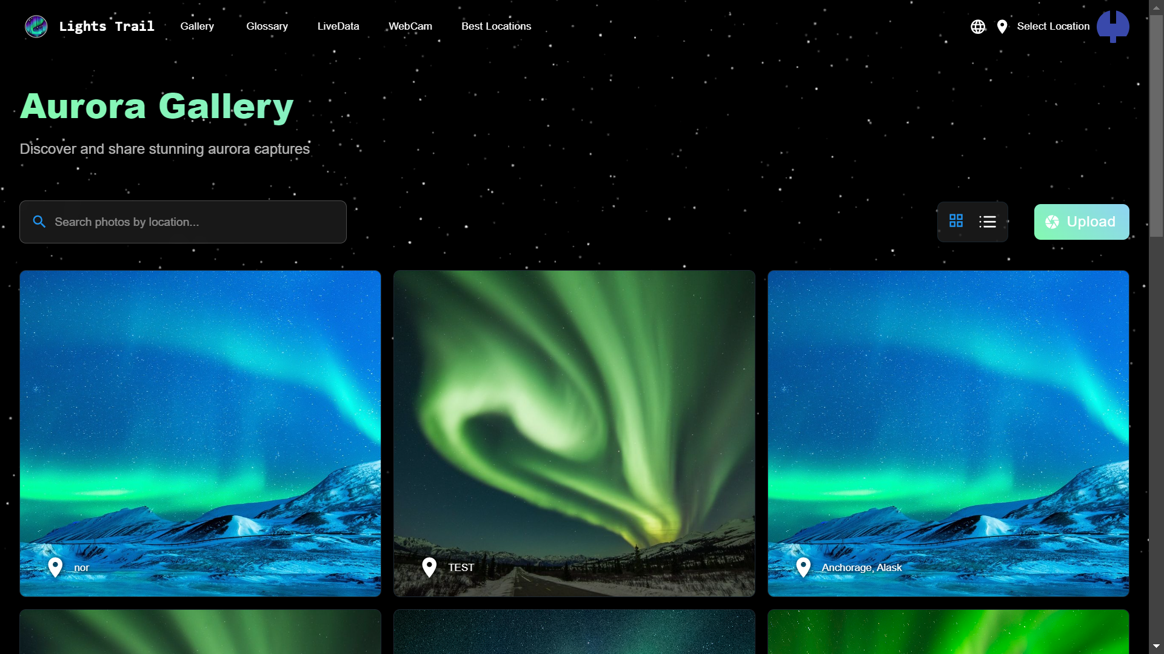
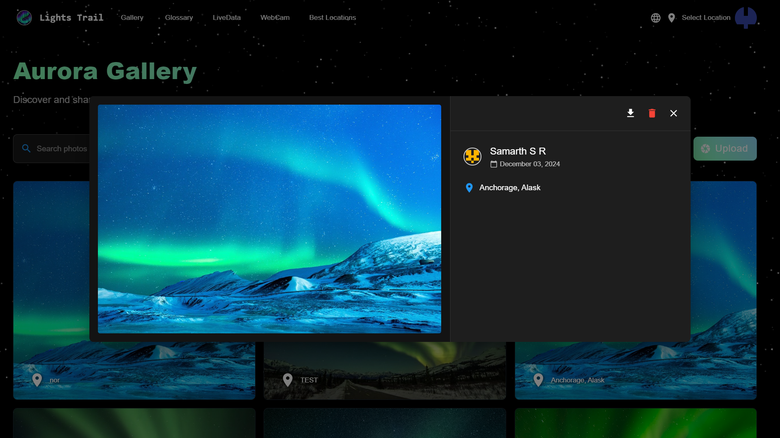
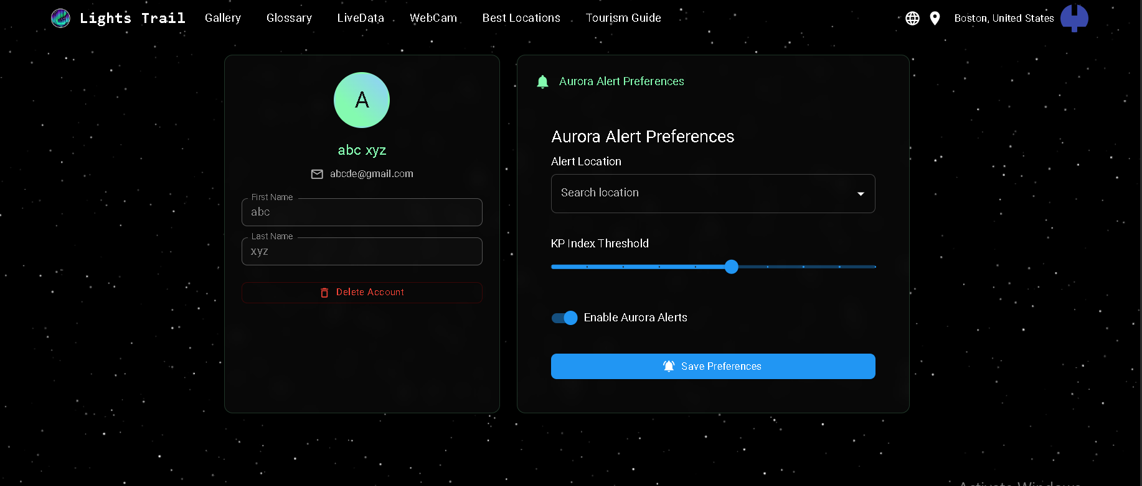
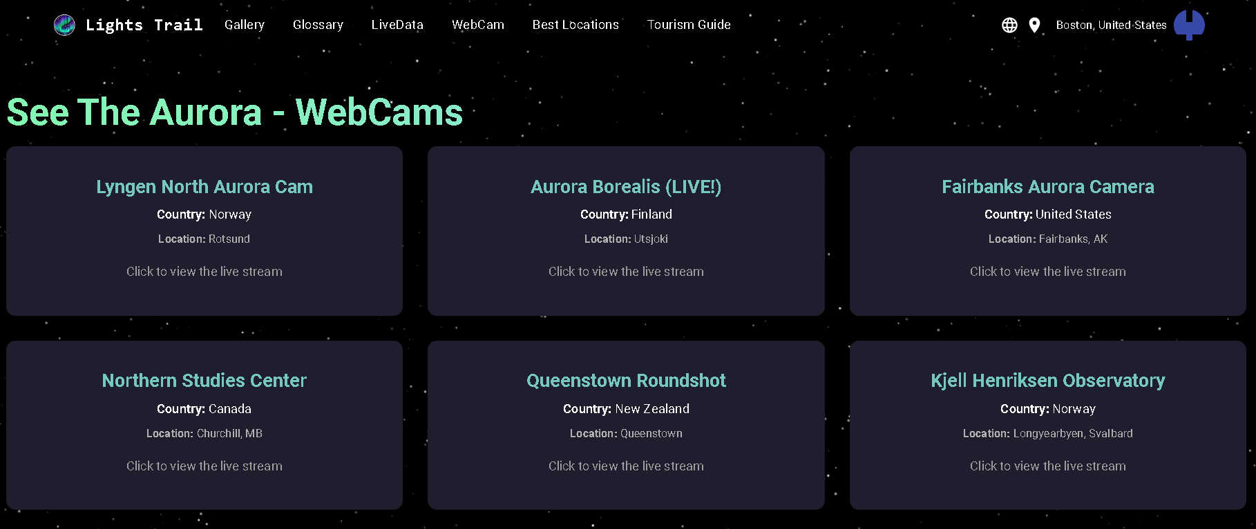

Feature Screenshots

Slide 8
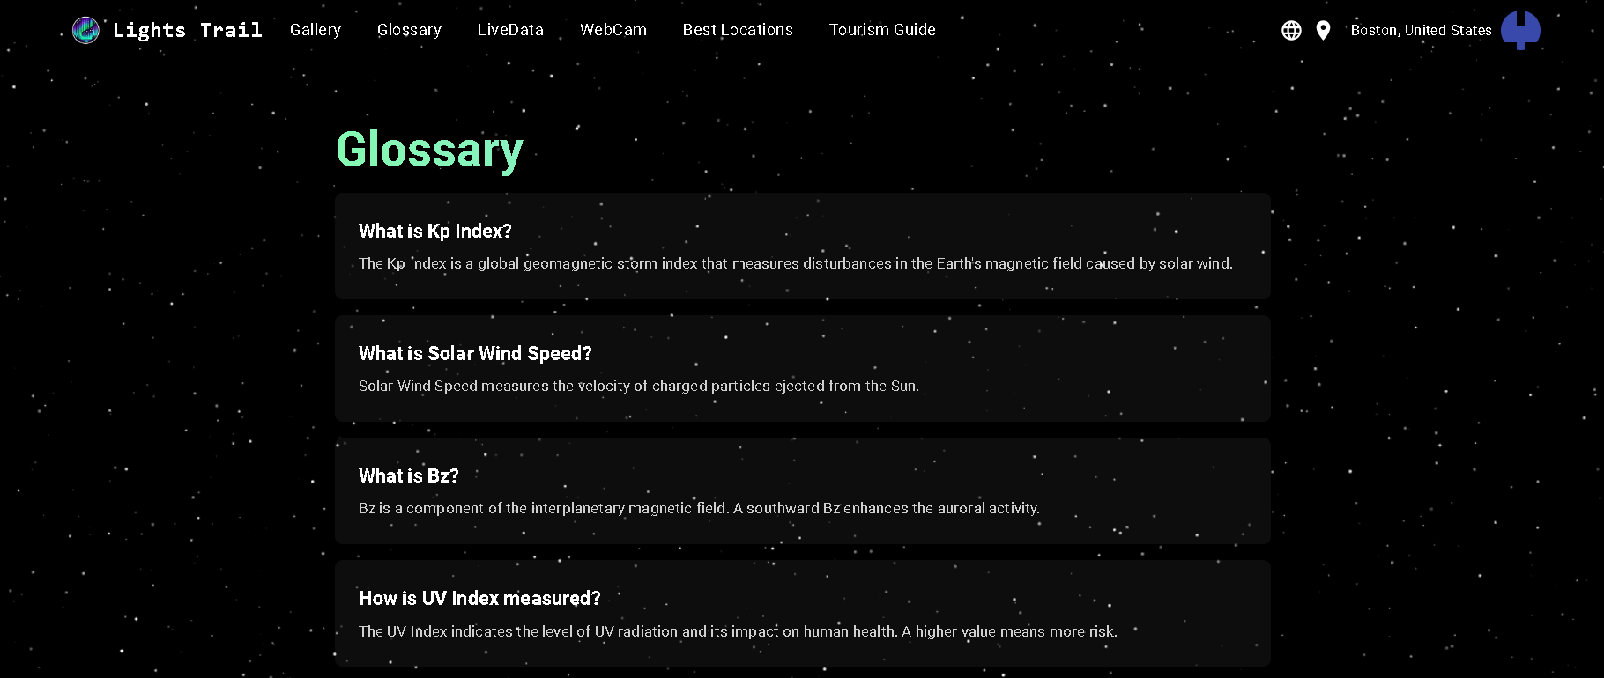
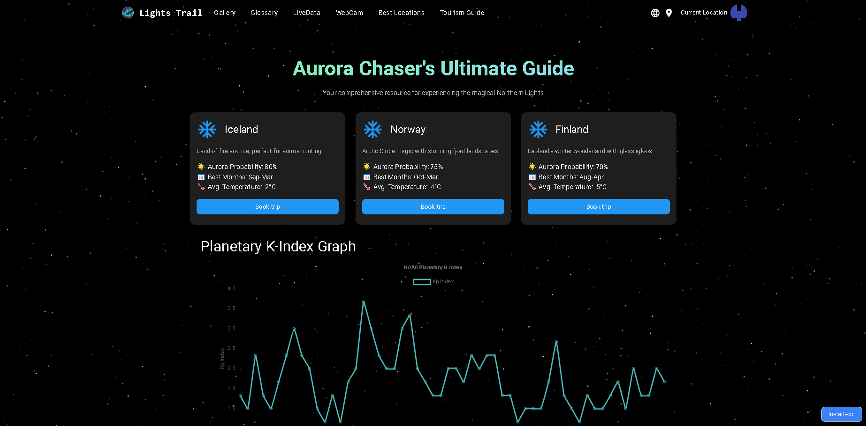
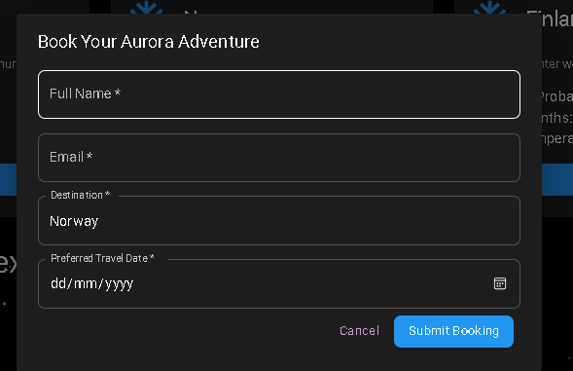
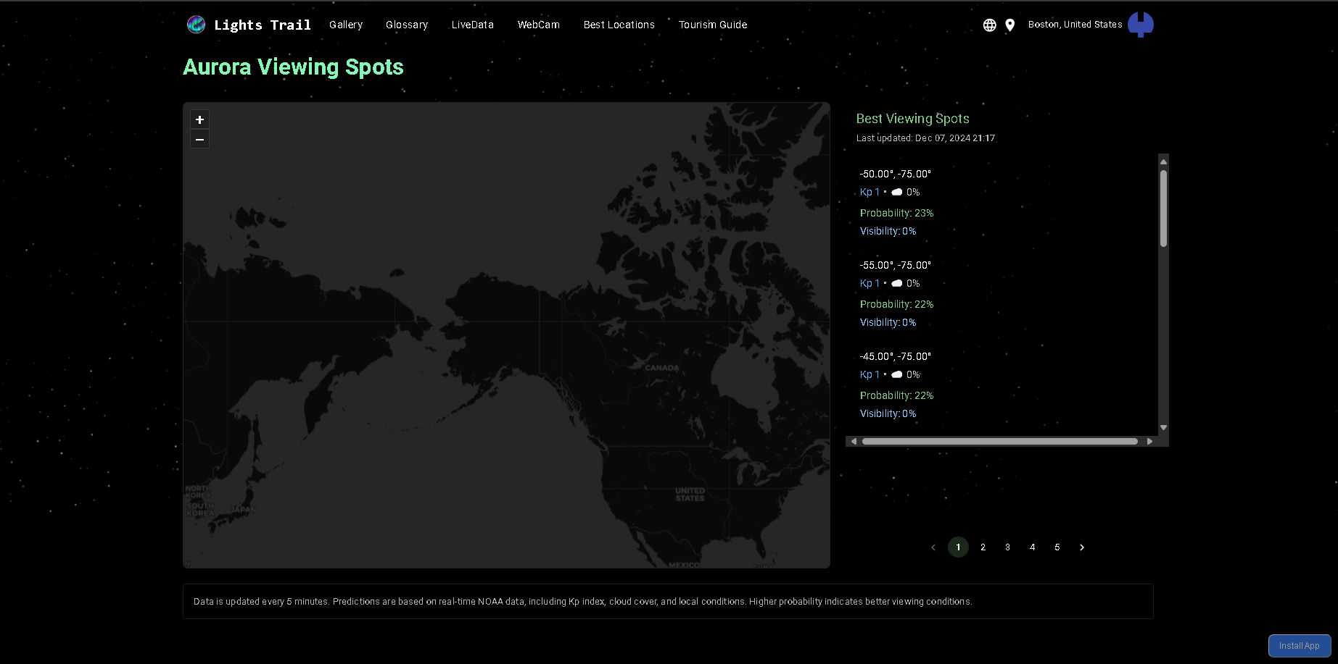
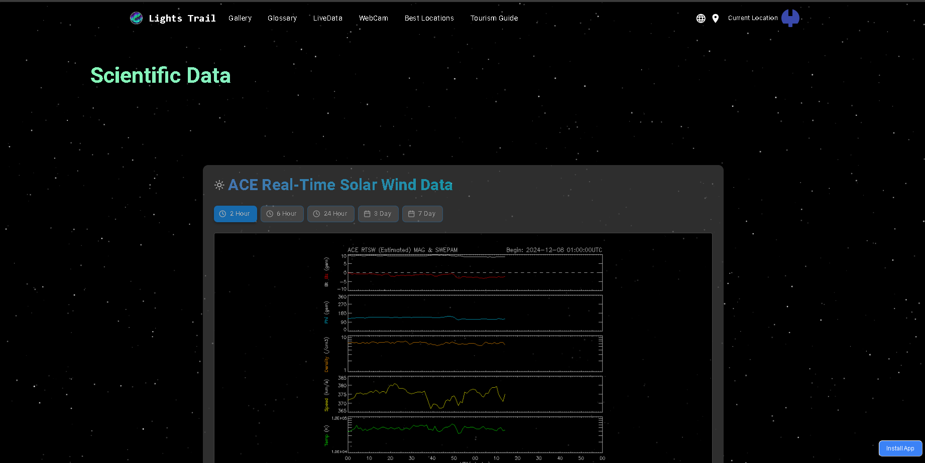
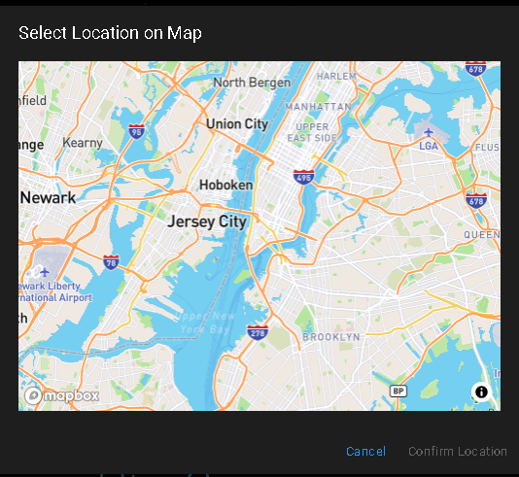

Slide 9
THANK YOU!!!

